Slide 1
FDA Critical Path Project
“Generation and Review of Regulatory-Grade Computational Evidence Using a Generic Inferior Vena Cava Filter”
Summary of Preliminary FEA

Slide 2
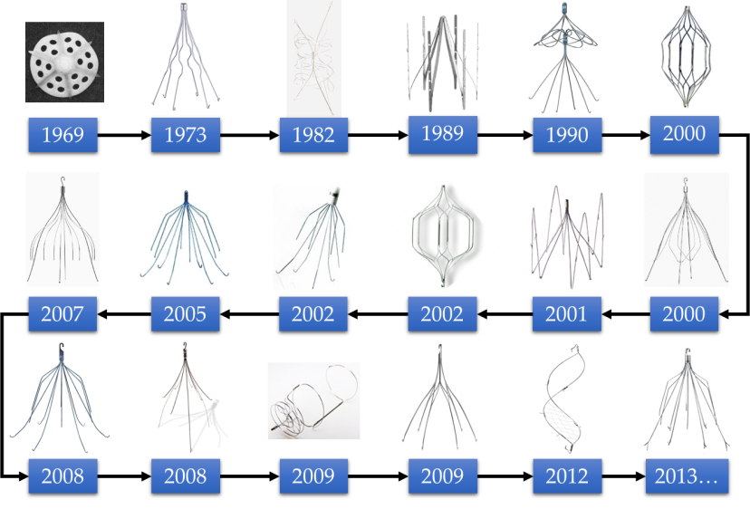
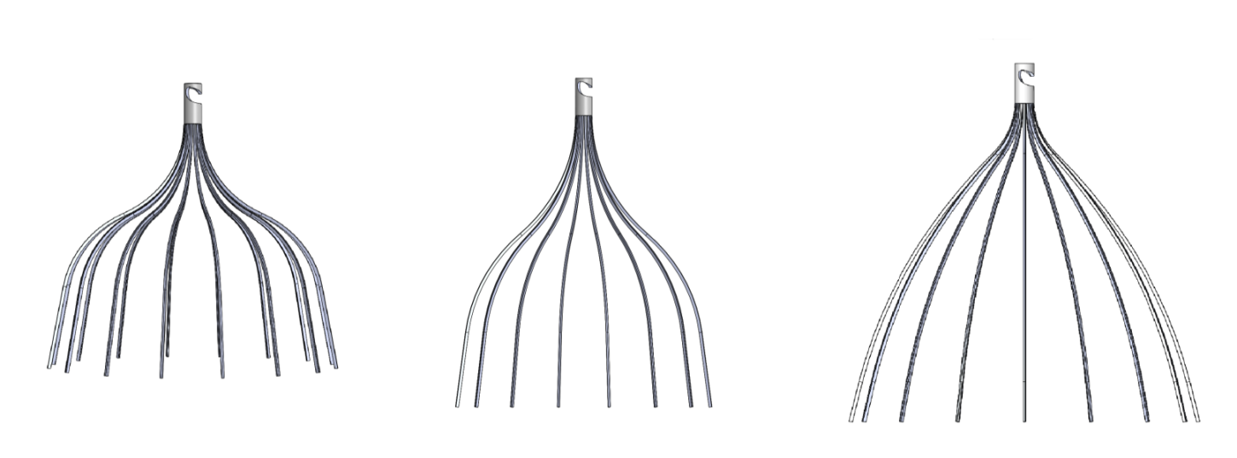
The objectives of this project are to…
Develop a generic IVC filter
Predict & demonstrate:
fatigue resistance
embolus-trapping efficiency
Ideally,
single strut shape (simplify fatigue simulation/testing)
resist tilt, migration, and vein wall perforation
???
*designs investigated in previous FEA simulations
Notes:
Our objective is to develop a “generic” IVC filter for which we will generate “regulatory grade” computational evidence.
Specifically, we will predict & demonstrate the fatigue performance and embolus-trapping efficiency of the device.

Slide 3
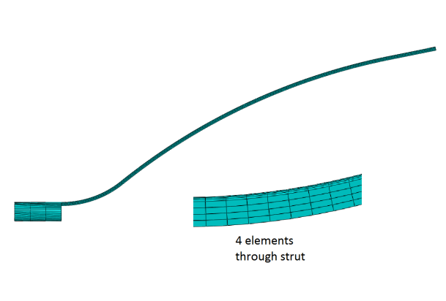

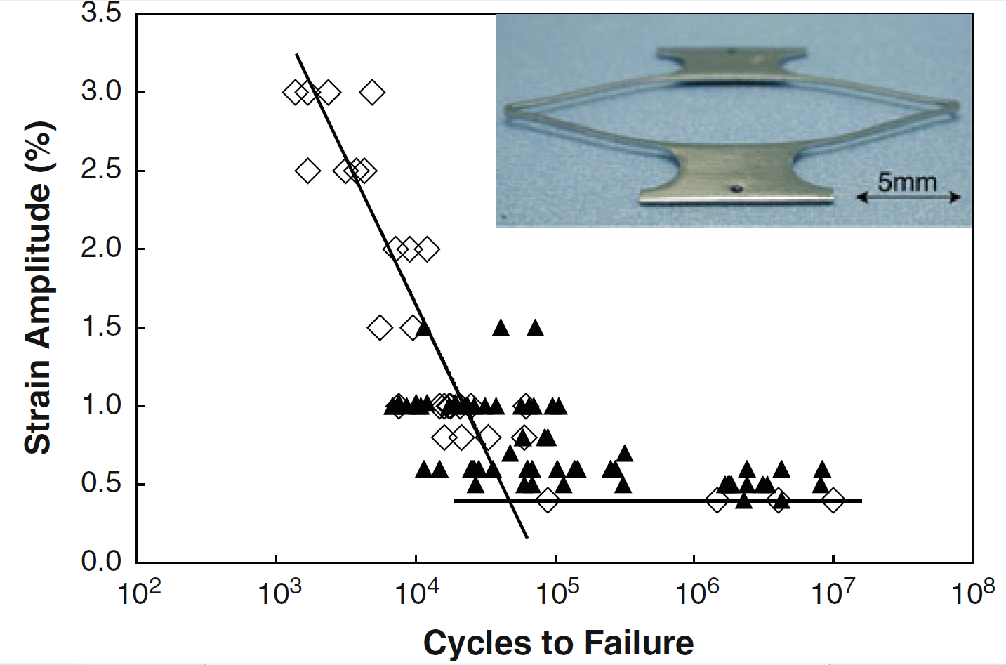
FEA performed to evaluate filter design
Setup:
ABAQUS Dynamic/Implicit (quasi-static); 10x mass scaling
C3D8I elements (4 per strut thickness & width; ~3,000 to 6,000 per strut)
SE508 nitinol (material properties from Craig Bonsignore’s example on GitHub)
Simulated conditions → extracted quantities
Sheathing → prestrain
Filter placement → contact force/area
Valsalva → mean/amplitude strain
collapsibility index
CI = (d_{max}- d_{min})/d_{max}
Valsalva
IVC
cross-
section
breathing
d_{max}
d_{min}
?
simulated CI = 0.5
(see Laborda et al. 2014)
Pelton, A. R. (2011). J. Mater. Eng. Perform., 20(4-5), 613–617
Two IVC diameters considered (human variability):
14mm (3.5mm wall displacement during Valsalva)
28mm (7.0mm wall displacement during Valsalva)
We assume Valsalva is the limiting loading scenario for fatigue life
Notes:
FEA simulations were used to evaluate the performance of the candidate designs
A mesh refinement study was also performed (4x4 versus 8x8 elements per strut cross-section; difference in maximum strain amplitude of 10%)
Valsalva is the limiting case for fatigue life (larger displacements than those associated with respiration)
N ≈ 4 million (“worst case” scenario assuming chronic cough for 10 years; see discussion in CP project outline & Birring et al. 2006)
CI = 0.5 +/- 0.04 , n=100 patients (see discussion in CP project outline and Laborda et al. 2014)
Strain amplitude and mean strain are calculated using a tensor-based approach, e.g.: E_strain_amplitude_scalar = max_abs_principal{0.5*(E_logarithmic_strain_tensor_loaded – E_logarithmic_strain_tensor_unloaded)}
Further justification needed for chosen “performance measurements” and their target values:
“Contact length” instead of “contact area”? (quantification of contact area with FEA is challenging; accurate results require very fine meshes. However, the predicted trends may still be useful)
What is a reasonable range for the per-strut “contact force”? (see Dowell et al. 2015, Garcia et al 2012; vein wall perforation observed around 1N (upper limit))
Are there other quantities we should consider?

Slide 4
Performance goals are set for quantities extracted from FEA simulations
 | distal end contacts wall? | prestrain (max/min prin. LE) | contact force (N) (per strut) | contact area (mm²) (per strut) | ε amplitude, Valsalva (CI=0.5) | mean ε, Valsalva (CI=0.5)
target | yes | <6% | 0.010 to 0.100 | >0.05? | <0.4% | <6%
*to avoid plastic deformation during sheathing
Notes:
FEA simulations were used to evaluate the performance of the candidate designs
A mesh refinement study was also performed (4x4 versus 8x8 elements per strut cross-section; difference in maximum strain amplitude of 10%)
Valsalva is the limiting case for fatigue life (larger displacements than those associated with respiration)
N ≈ 4 million (“worst case” scenario assuming chronic cough for 10 years; see discussion in CP project outline & Birring et al. 2006)
CI = 0.5 +/- 0.04 , n=100 patients (see discussion in CP project outline and Laborda et al. 2014)
Strain amplitude and mean strain are calculated using a tensor-based approach, e.g.: E_strain_amplitude_scalar = max_abs_principal{0.5*(E_logarithmic_strain_tensor_loaded – E_logarithmic_strain_tensor_unloaded)}
Further justification needed for chosen “performance measurements” and their target values:
“Contact length” instead of “contact area”? (quantification of contact area with FEA is challenging; accurate results require very fine meshes. However, the predicted trends may still be useful)
What is a reasonable range for the per-strut “contact force”? (see Dowell et al. 2015, Garcia et al 2012; vein wall perforation observed around 1N (upper limit))
Are there other quantities we should consider?

Slide 5
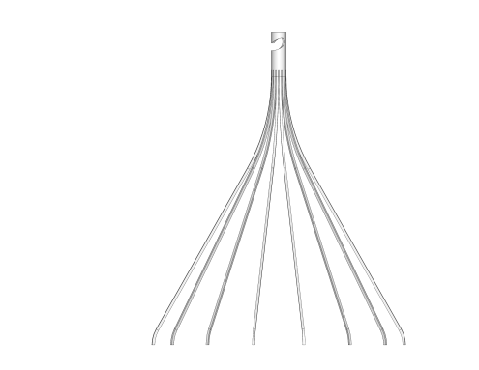
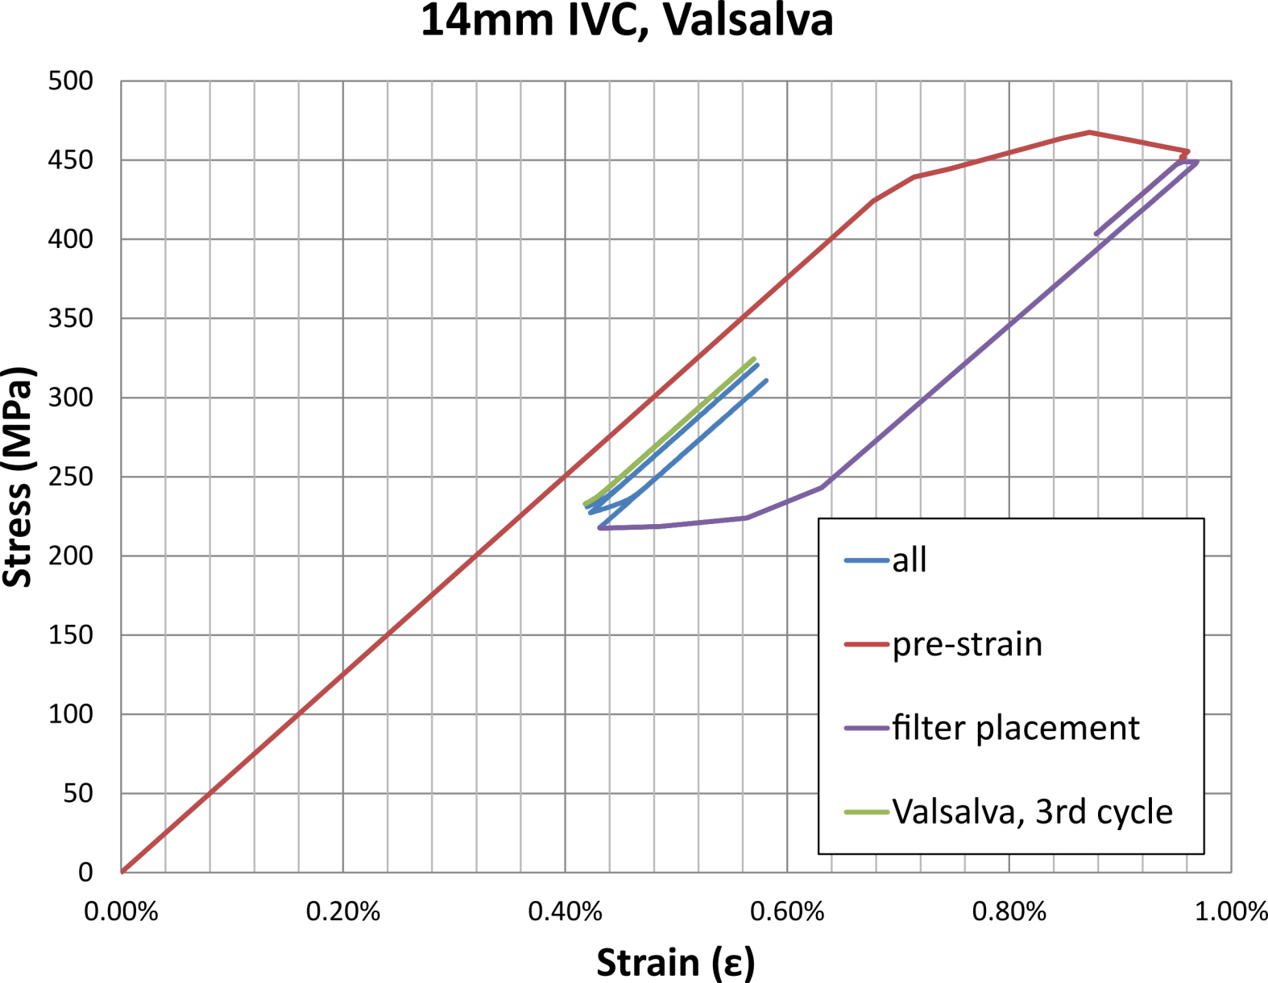
Stress-strain history diagram (Rev1)
ε_{pre-strain}
2 x ε_{amp}
ε_{mean}

Slide 6
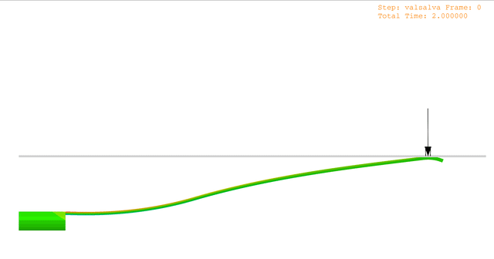
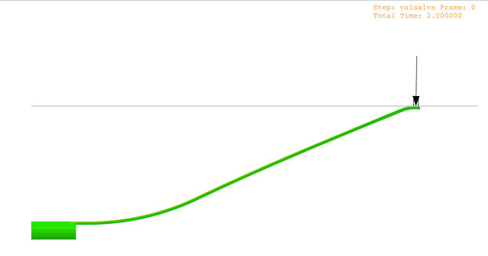
Valsalva (fatigue loading) (Rev1)
contact point(s)
IVC diameter
14mm
3.5mm
contact with friction
*FEA simulations of Valsalva shown for reference; note that the contact point between the IVC wall and the filter strut changes as the strut deforms
1DOF
IVC wall
28mm
7mm

Slide 7
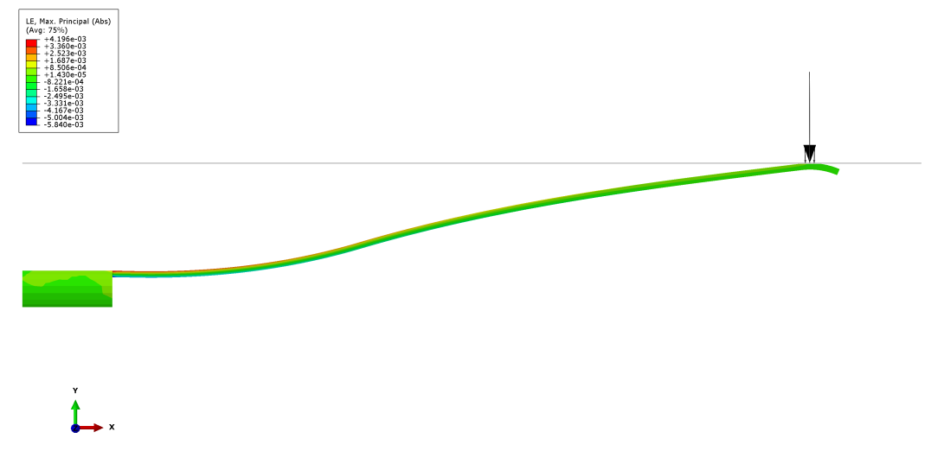
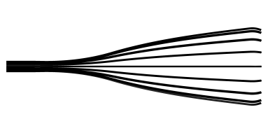
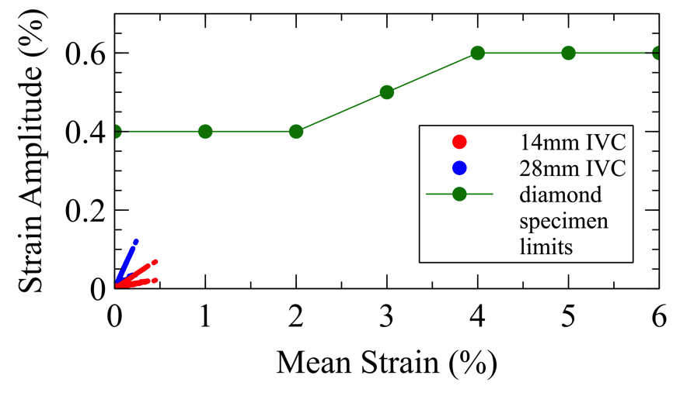
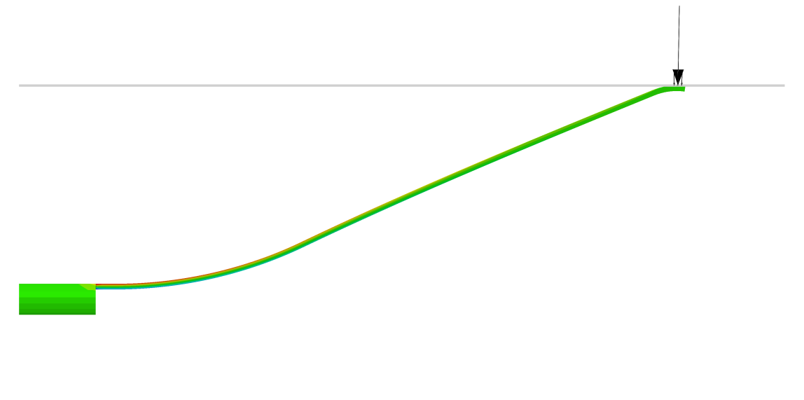
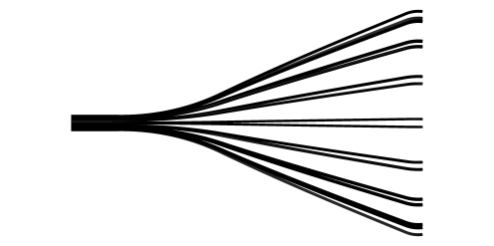
Results summary (Rev1)
IVC diameter
Filter Placement
Valsalva
14mm
Strain Limit Diagram (SLD)
IVC wall
28mm
FS ≈ 3.33?
*results from third Valsalva cycle
IVC diamter | distal end contacts wall? | prestrain (max/min prin. LE) | contact force (N) (per strut) | contact area (mm²) (per strut) | ε amplitude, Valsalva (CI=0.5) | mean ε, Valsalva (CI=0.5)
14mm | yes | 0.80% | 0.028 | 0.018 | 0.07% | 0.45%
28mm | yes | 0.80% | 0.010 | 0.018 | 0.12% | 0.24%

Slide 8
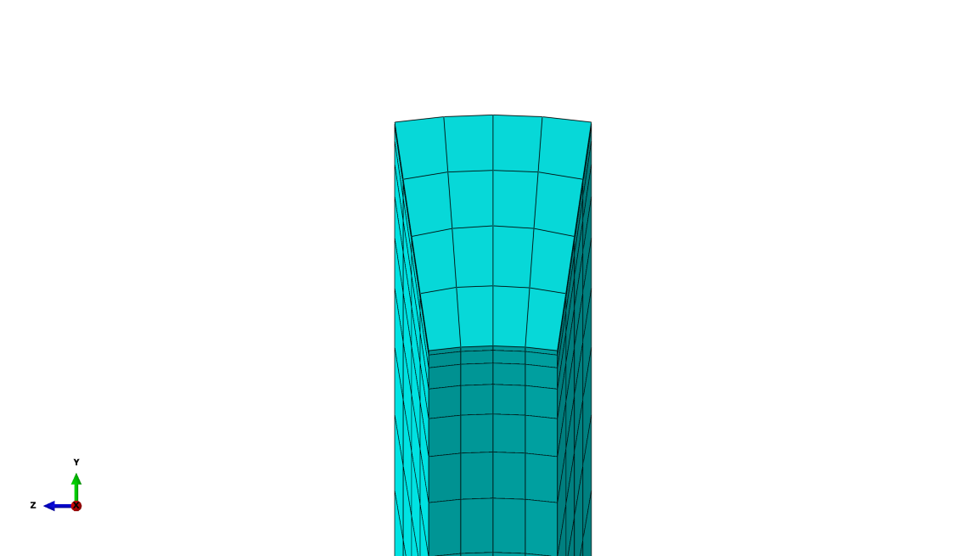
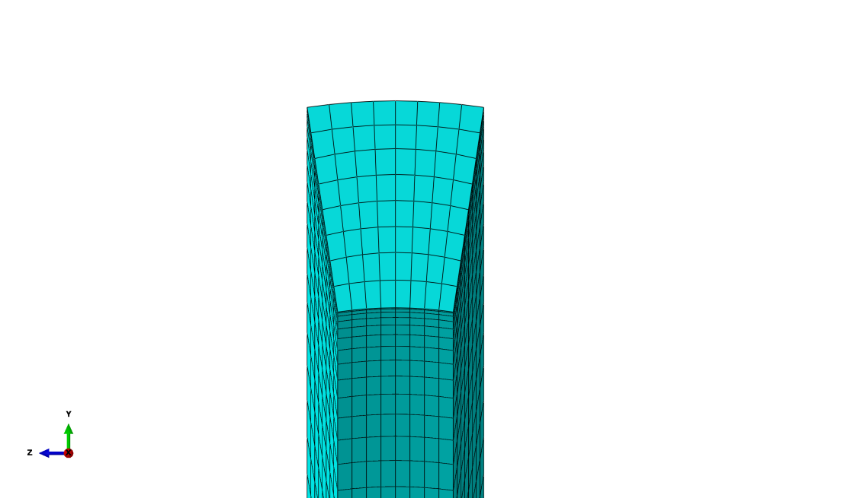
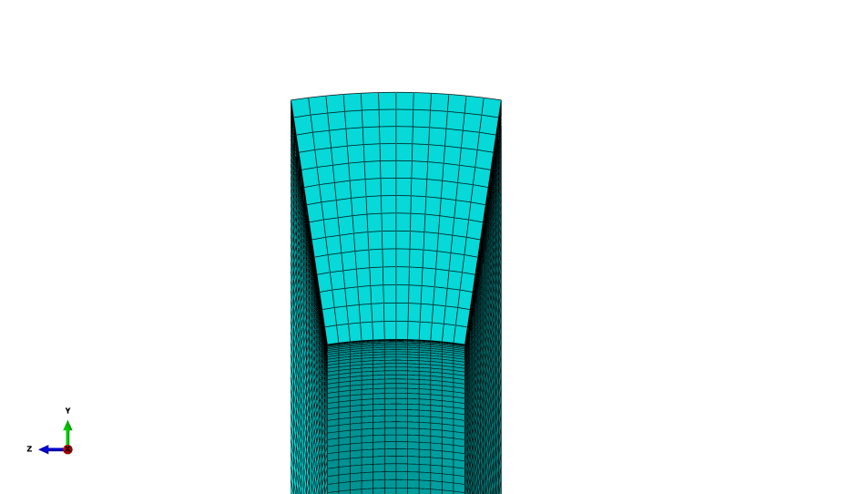
Mesh refinement (Rev1)
IVC diamter | distal end contacts wall? | prestrain (max/min prin. LE) | contact force (N) (per strut) | contact area (mm²) (per strut) | ε amplitude, Valsalva (CI=0.5) | mean ε, Valsalva (CI=0.5)
coarse (4x4) | yes | 0.80% | 0.0096 | 0.018 | 0.121% | 0.24%
medium (8x8) | yes | 0.92% | 0.0096 | 0.0048 | 0.134% | 0.26%
fine (12x12) | yes | 1.04% | 0.0102 | 0.0050 | 0.139% | 0.27%
GCI: -2.81%
coarse
medium
fine

Slide 9

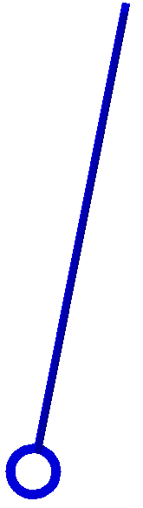
Eccentric loading of filter strut (Rev1)
IVC diamter | distal end contacts wall? | prestrain (max/min prin. LE) | contact force (N) (per strut) | contact area (mm²) (per strut) | ε amplitude, Valsalva (CI=0.5) | mean ε, Valsalva (CI=0.5)
28mm | yes | 0.80% | 0.010 | 0.018 | 0.12% | 0.24%
28mm | yes | 0.80% | 0.0086 | 0.0091 | 0.14% | 0.26%
a
b
a
b

Slide 10
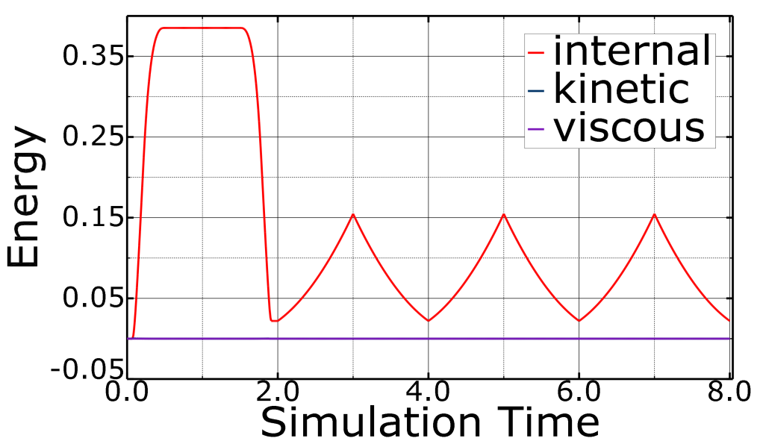
Static/Implicit vs. Dynamic/Implicit (Rev1)
IVC diamter | distal end contacts wall? | prestrain (max/min prin. LE) | contact force (N) (per strut) | contact area (mm²) (per strut) | ε amplitude, Valsalva (CI=0.5) | mean ε, Valsalva (CI=0.5)
28mm | yes | 0.798% | 0.00884 | 0.0182 | 0.122% | 0.239%
28mm | yes | 0.797% | 0.00959 | 0.0182 | 0.121% | 0.238%
Static/Imp
Dynamic/Imp
Dynamic/Imp
*Simulations were performed using Abaqus Standard, Dynamic/Implicit to increase stability of contact interactions. Simulations performed using Static/Implicit yield similar results, but do not converge in some cases.

